Slide 1

DSCI 340 Final Project
Joshua Grant

Slide 2
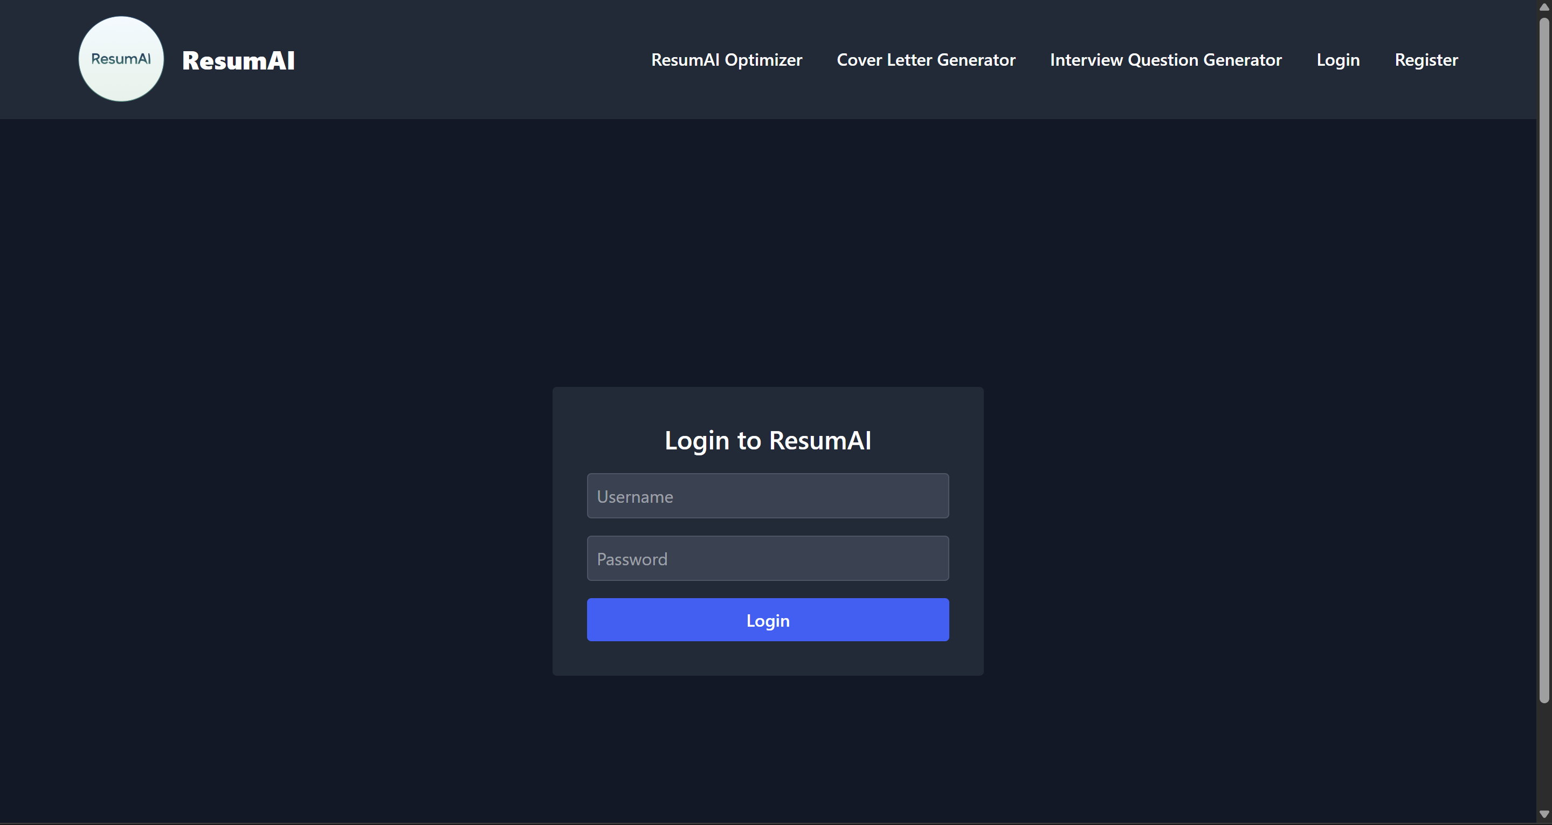
User Login

Slide 3
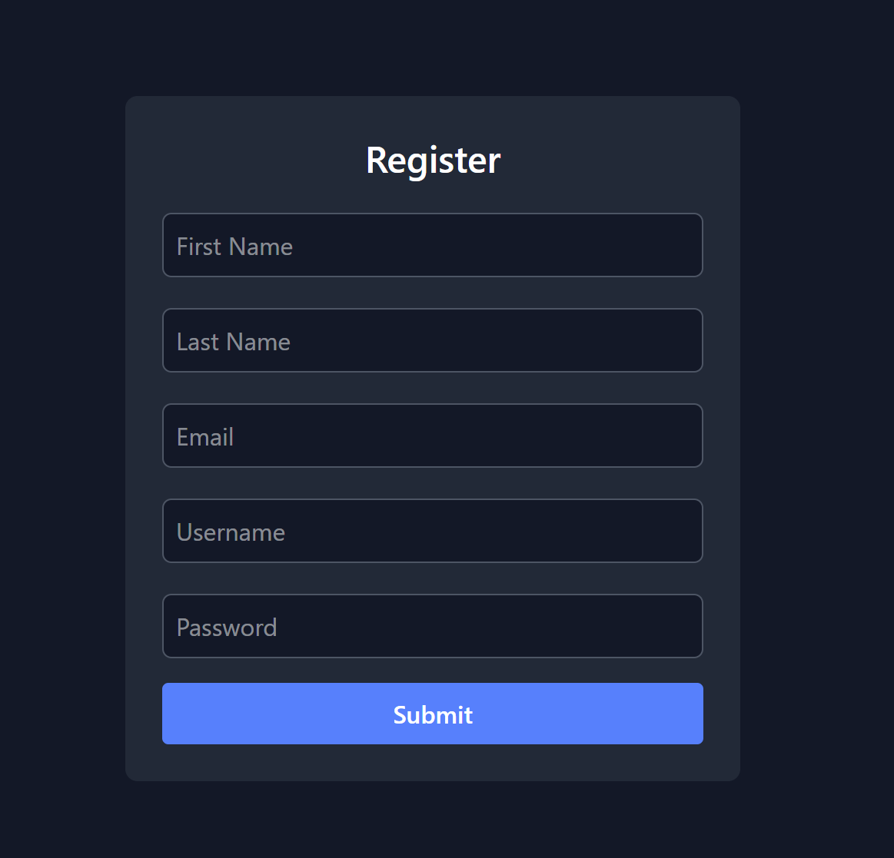
User Registration

Slide 4
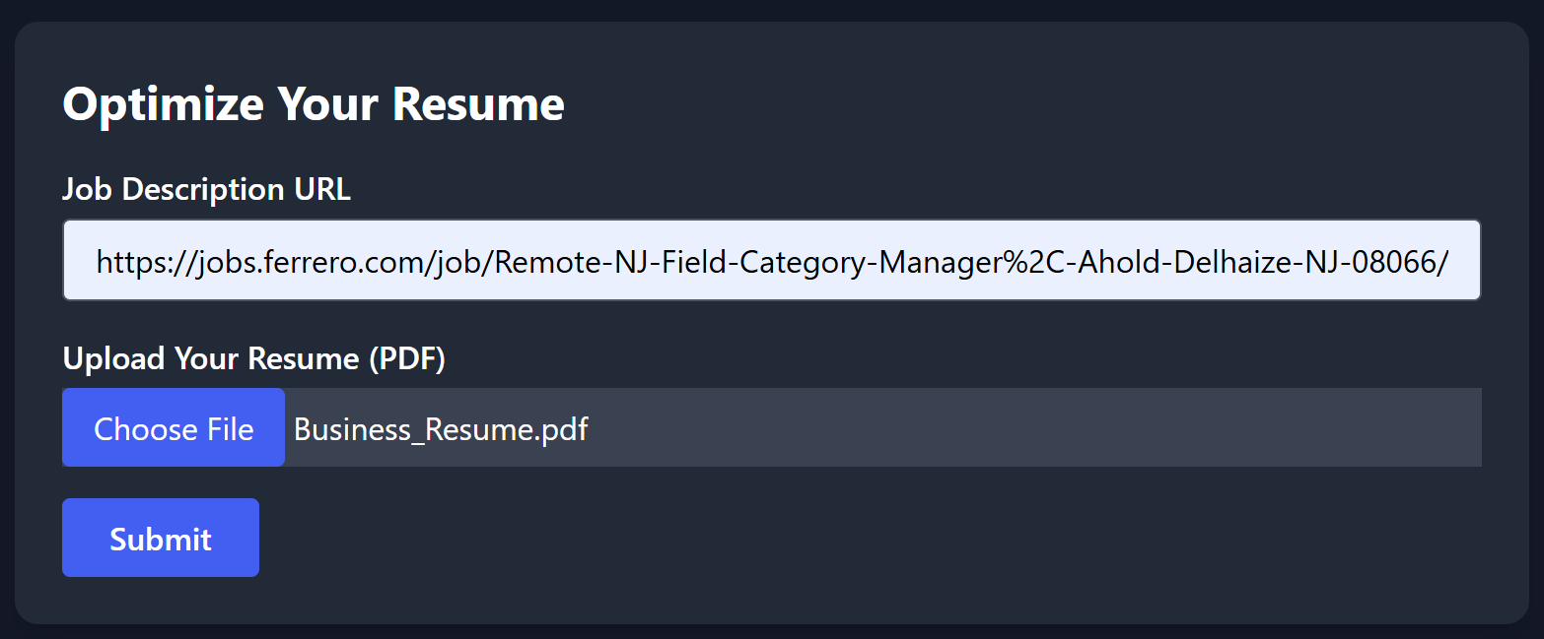
Resume Optimizer

Slide 5
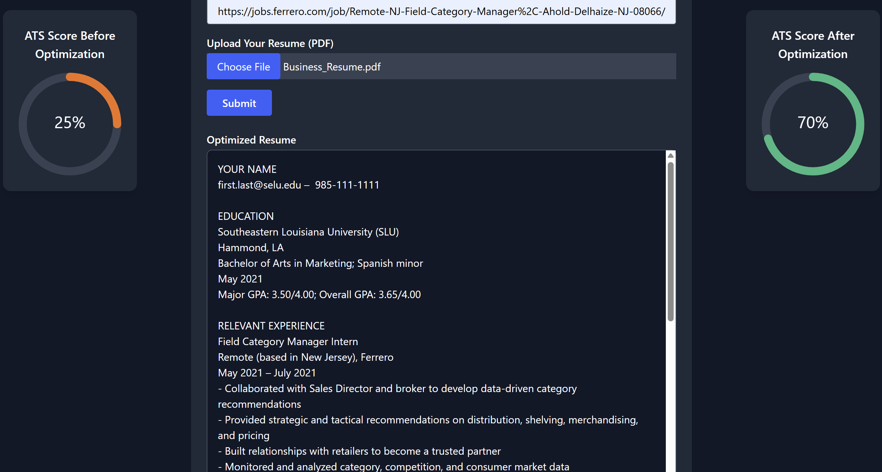
Resume Optimizer Output
Given a URL and a resume in PDF format, the web app will output an ATS score, a new and improved resume, and a list of the changes made.

Slide 6
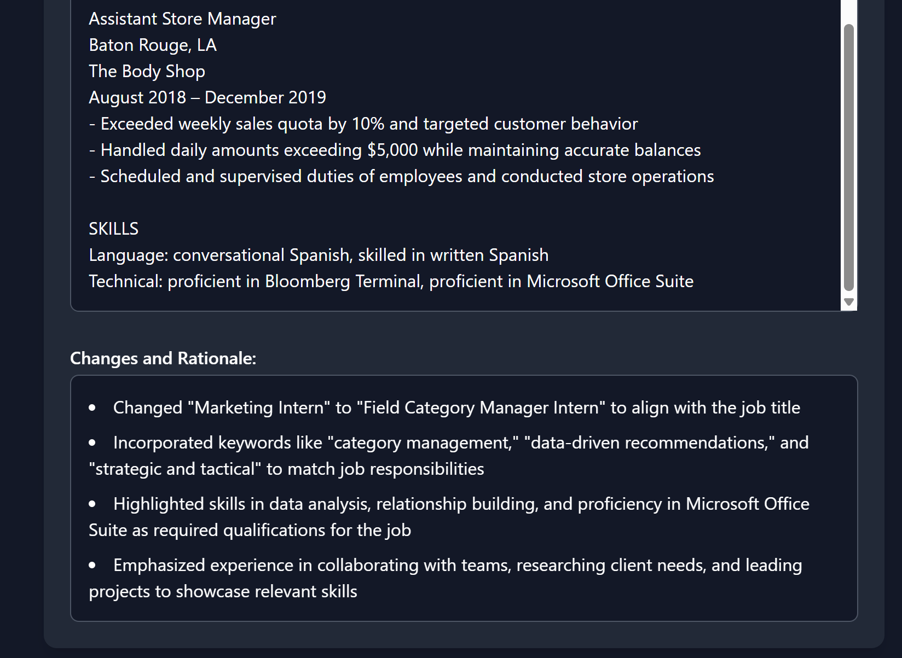
Resume Optimizer Output Continued

Slide 7
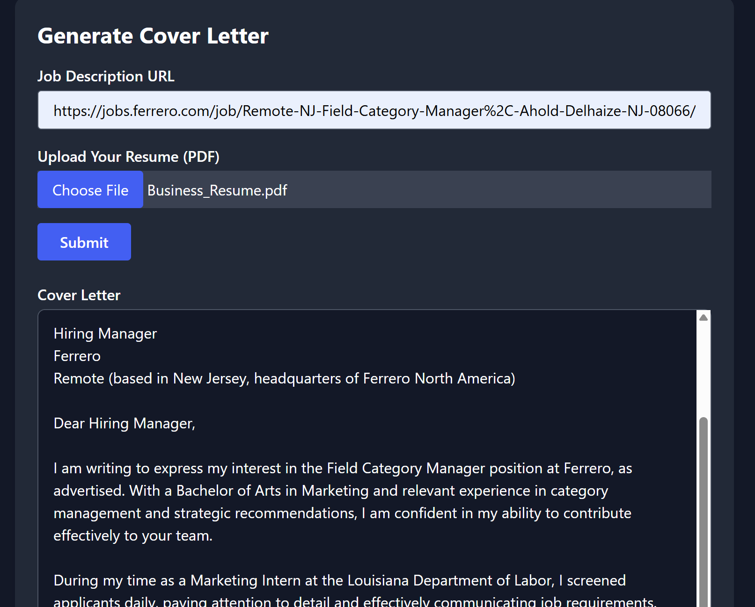
Cover Letter Generator
Given a URL and a resume in PDF format, the web app will output a cover letter specific to the job URL you gave it.

Slide 8
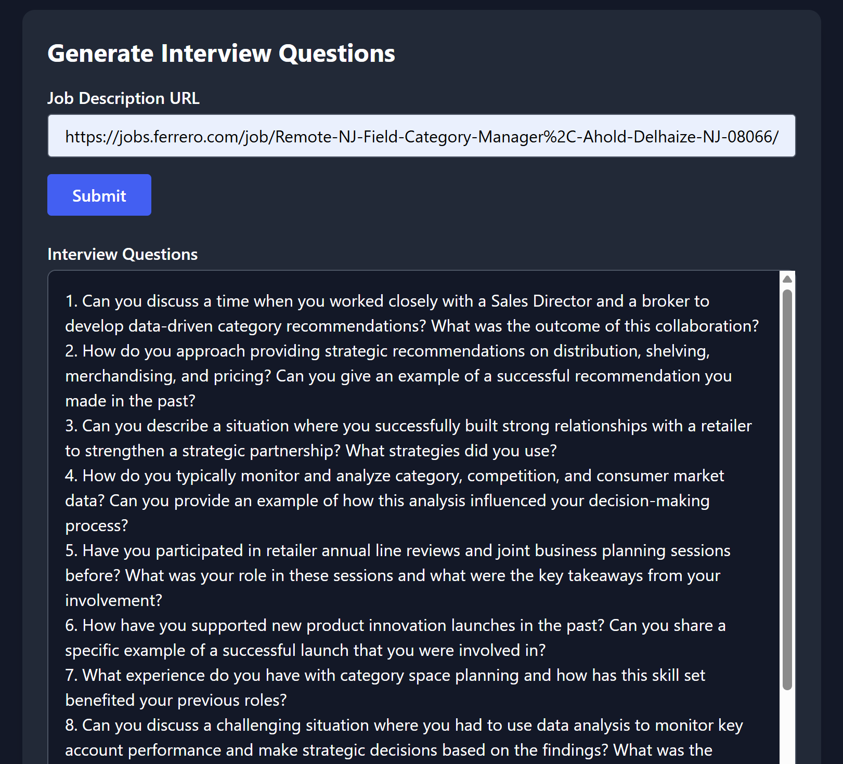
Interview Question Generator
Given a URL to a job description, the app will generate 10 interview questions based on that job.

